Slide 1
"Mastering Atari Games and Beyond: A Journey from Deep Q-Learning to Adaptive Recurrent Networks"
Avinash Shukla(210236)
Bhavaj Singla(210265)
Mohd. Sibtain Ansari(210616)
Link - PDF Explanation of DQN
Link - Video Link

Slide 2
Resources:
Deep Recurrent Q-Learning for Partially Observable MDPs Link
Deep Q-Learning with Recurrent Neural Networks Link
Playing Atari with Deep Reinforcement Learning Link
Barton and Sutton Book

Slide 3
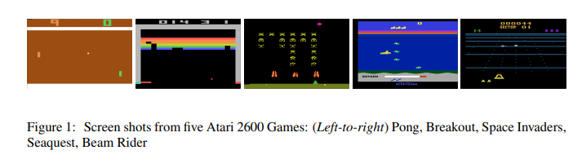
Playing Atari with Deep Reinforcement Learning

Slide 4
Challenges for RL from Deep Learning Perspective
Scalar Rewards, Delayed, Frequently sparse and Noisy
No hand-labelled training data available
Data samples are highly correlated and dependant on each other
Data distribution changes as the algorithm learns new behaviours and policy

Slide 5
Background
Components:
Environment (E): Atari emulator
Action Space: A={1,2,3…K} action denoted by a_{t}
Environment Replay Buffer(size ~1 million) denoted by D
Total Future Reward denoted by
Image obtained from the emulator x_{t} 𝜖 R^{d}
Optimal Action Value function

Slide 6


Optimising the Action-Value Function to Optimal Value
Bellman Equation:
Old Method that doesn’t work for our Problem:
Functional Approximators: In reinforced learning setting, we can define a linear functional approximator, non-linear as well, and estimate the optimal Q values. The estimated Q value approximator can be trained by minimising the Loss Function.
We minimise the value of the Loss Function using Stochastic Gradient Descent, keeping the previous iteration parameters ie y_{i} fixed.

Slide 7
Properties of the Algorithm
Model free: samples are taken directly from E, no state transition probabilty is calculated
Off-Policy: greedy strategy of action selection as in Q learning
Epsilon-Soft: Each action has a certain probability of selection exploration is supported
Deadly Triad of Divergence: Model-free, non-linear function approximation, off-policy methods

Slide 8
Experience Replay:
Store agent’s experience at each time step e_{t} = (s_{t}, a_{t}, r_{t} , s_{t+1}) in the Experience buffer of constant size. Recent 1 million steps are stored in the buffer.
Apply Q-learning updates, minibatch updates to sample of experience drawn from experience buffer. After updation, agent uses e-greedy policy to choose next action
Q-function works on fixed length representation of histories produced by a function ɸ
Each step of experience is used multiple times in different weight updates
Learning from continuous samples is inefficient. Randomisation breaks these correlations and decreases variance of updates.
Prevents Divergence of the function

Slide 9
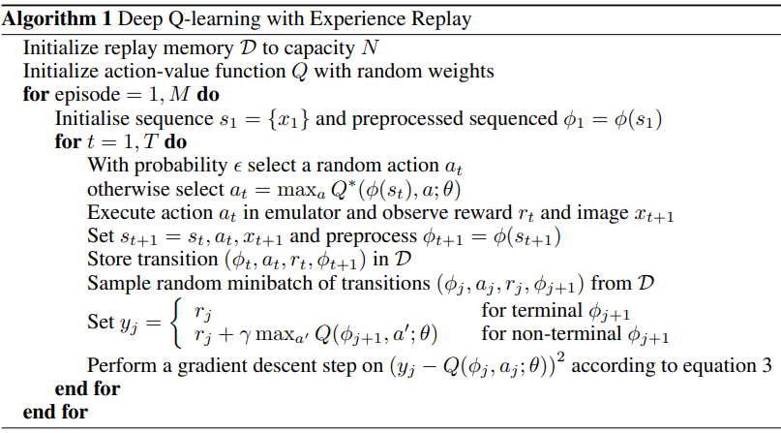

Slide 10
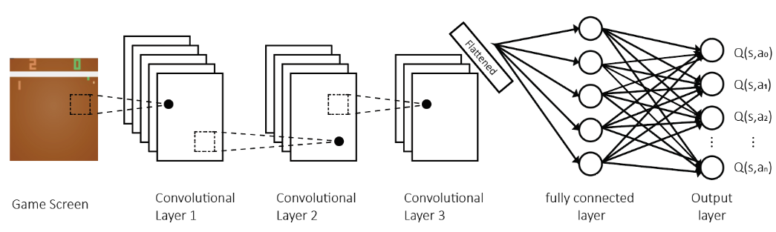
Model Architecture and Preprocessing :
Reduces the size of the image from 210 * 160 pixels and 128 color palette to 84 * 84 region of playing area and grayscaling
The Transformation function(ɸ) takes last 4 buffer updates to transform the image
Neural Network is constructed by taking only the state value as input and output nodes each mapping to one of the action value. Output is the Q-value of the state-action pair.

Slide 11
Experiments :
E-greedy policy is used with epsilon linearly annealed from 1 to 0.1 over the first million frames and fixed at 0.1 thereafter. We train for a total of 10 million frames and replay memory of 1 million is used.
All positive, zero and negative rewards are scaled to 1, 0 or -1.
K-th frame skipping technique is used.

Slide 12
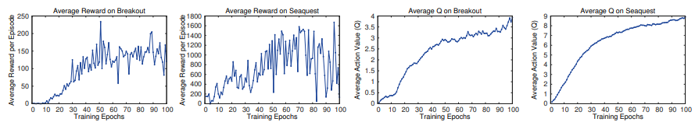
Training and Stability Results :
Our Metric is the total reward the agent collects in an episode or game averaged over a number of games, we periodically compute it during training. The average total reward metric tends to be very noisy because small changes to the weights of a policy can lead to large changes in the distribution of states the policy visits.
Another, more stable, metric is the policy’s estimated action-value function Q, which provides an estimate of how much discounted reward the agent can obtain by following its policy from any given state.

Slide 13
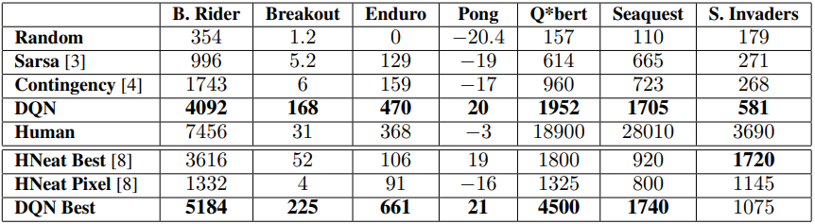
Comparison with other Methods :
DQN was compared with other methods in RL like SARSA, Contingency.
Results were also compared with that of human players

Slide 14
Conclusion :
This paper introduced a new deep learning model for reinforcement learning, and demonstrated its ability to master difficult control policies for Atari 2600 computer games, using only raw pixels as input. We also presented a variant of online Q-learning that combines stochastic minibatch updates with experience replay memory to ease the training of deep networks for RL. Our approach gave state-of-the-art results in six of the seven games it was tested on, with no adjustment of the architecture or hyperparameters.

Slide 15
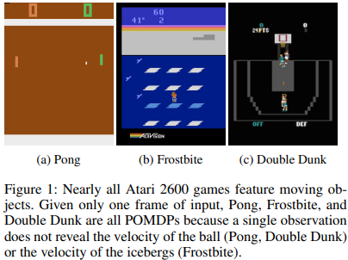
Deep Recurrent Q-Learning for Partially Observable MDPs

Slide 16
What Exactly is Partially Observable MDP?

Slide 17
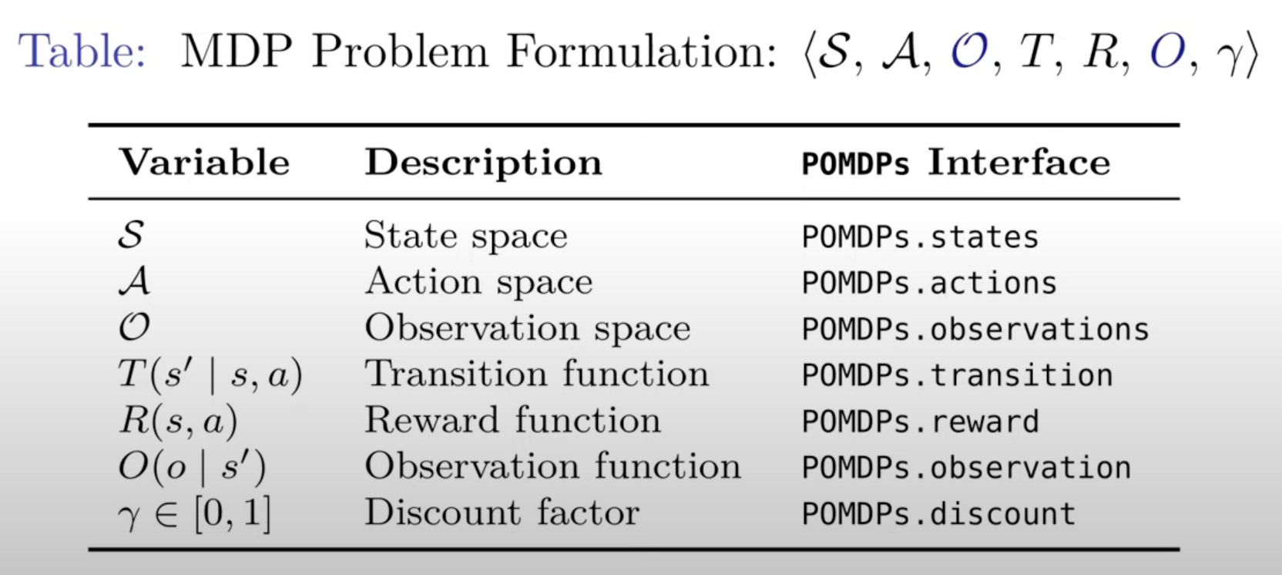
What is a POMDP?
A Partially observable Markov decision process (POMDP) is an MDP with state uncertainty meaning we cannot know the true state, only a belief about the true state using observations.
Formally a POMDP is defined by the following:

Slide 18
More About Observation Space and Observation Function
Observation Space:
The observation space (Ω) represents the finite or infinite set of all possible observations that the agent can receive from the environment.
The observation space encompasses all the information available to the agent about the current state of the environment, based on its sensors or perception mechanisms.
For example, in a robotics scenario, the observation space might include sensor readings such as distance measurements, camera images, or other environmental cues.

Slide 19
More About Observation Space and Observation Function
Observation Functions:
The observation function (O) maps the underlying system states to observations in the observation space.
It defines how the agent's observations are generated based on the true state of the environment.
Mathematically, the observation function takes as input the current system state and produces an observation according to a probability distribution.
The observation function encapsulates the uncertainty and noise in the agent's perception process, as well as any limitations in its sensing capabilities.
For instance, in a navigation task, the observation function might model how sensor measurements are affected by factors like occlusions, noise, or environmental conditions.

Slide 20
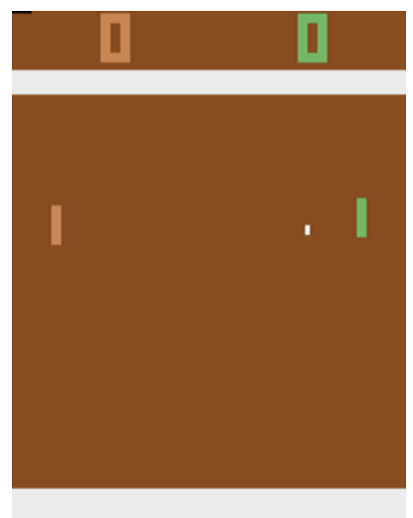
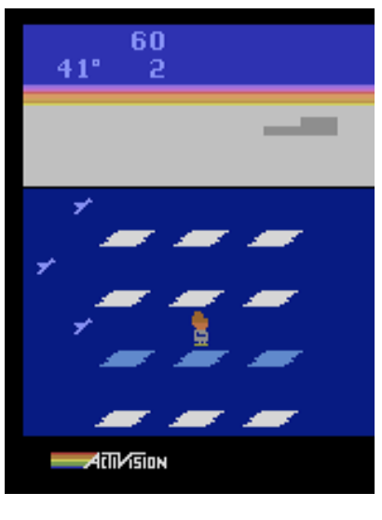
Atari Games: POMDP or MDP
Atari 2600 games are typically described by the console's 128 bytes of RAM, yet players only see the console-generated game screens.
Due to this discrepancy, a single game screen often fails to convey the complete game state, necessitating the expansion of the state representation.
DQN addresses this by incorporating the last four game screens into its state representation, thereby transforming many POMDPs into MDPs.
The challenge lies in introducing partial observability without reducing the number of input frames provided to DQN.

Slide 21
Flickering Atari Games
Introduction of Flickering Pong POMDP: Modification of the classic Pong game where each timestep screen is randomly fully revealed or obscured with a 50% probability.
This probabilistic obscuring induces an incomplete memory of observations necessary for Pong to qualify as a POMDP.
Success in Flickering Pong necessitates information integration across frames to estimate variables like ball location and velocity, considering the expected obscuring of half the frames.
Exploiting the history of game screens, particularly in detecting object velocity through convolutional filters, presents a significant opportunity.

Slide 22

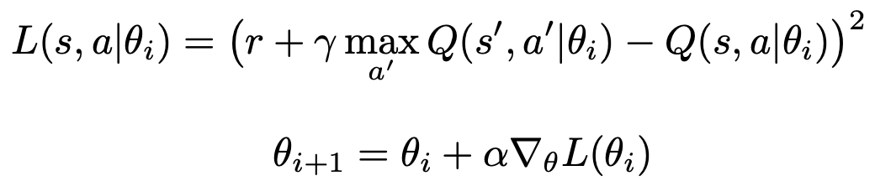
2.
Shortcomings in Traditional DQN

Slide 23
3. Introduction to DRQN

Slide 24
Shortcomings in Traditional DQN
Limited Memory in DQN:
DQNs have a fixed memory capacity, often restricted to the last few game screens, hindering their ability to effectively capture long-term dependencies in game states beyond a certain timeframe.
Shortcomings in Partial Observability Handling:
DQNs are ill-equipped to handle partially observable environments where crucial information is missing from the current observation, leading to suboptimal performance and limited adaptability in real-world tasks featuring incomplete state information.
Need for Improved Memory and Adaptability:
The inherent limitations of DQN in addressing partial observability highlight the necessity for a more sophisticated approach capable of integrating information across time steps and adapting to varying levels of observation quality, which motivates the exploration of recurrent neural networks like DRQN.

Slide 25
Deep Recurrent Neural Networks(DRQN)
We explore the concept of a deep recurrent Q-network (DRQN), a combination of a recurrent neural network (RNN) and a deep Q-network (DQN).
The idea being that the RNN will be able to retain information from states further back in time and incorporate that into predicting better Q values and thus performing better on games that require long term planning.
We examined several architectures for the DRQN. One of them is the use of a RNN on top of a DQN, to retain information for longer periods of time. This should help the agent accomplish tasks that may require the agent to remember a particular event that happened several dozens screen back.

Slide 26
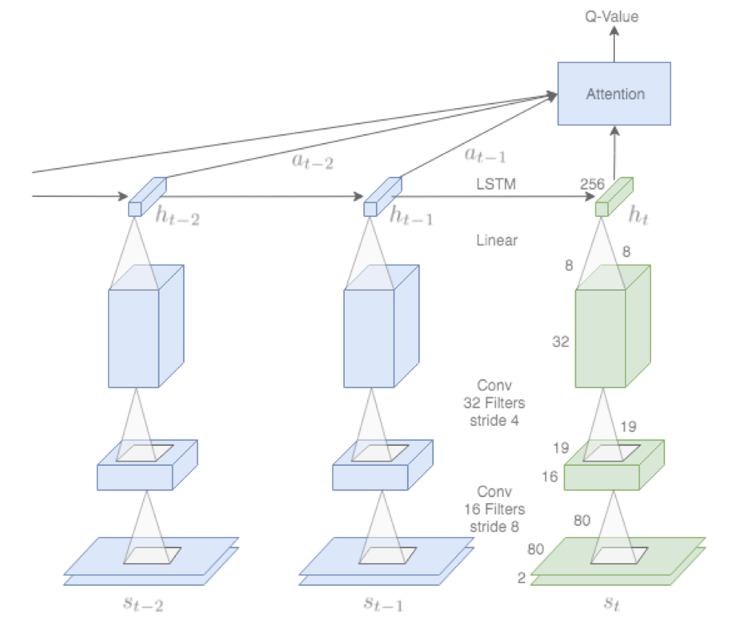
DRQN Architecture

Slide 27
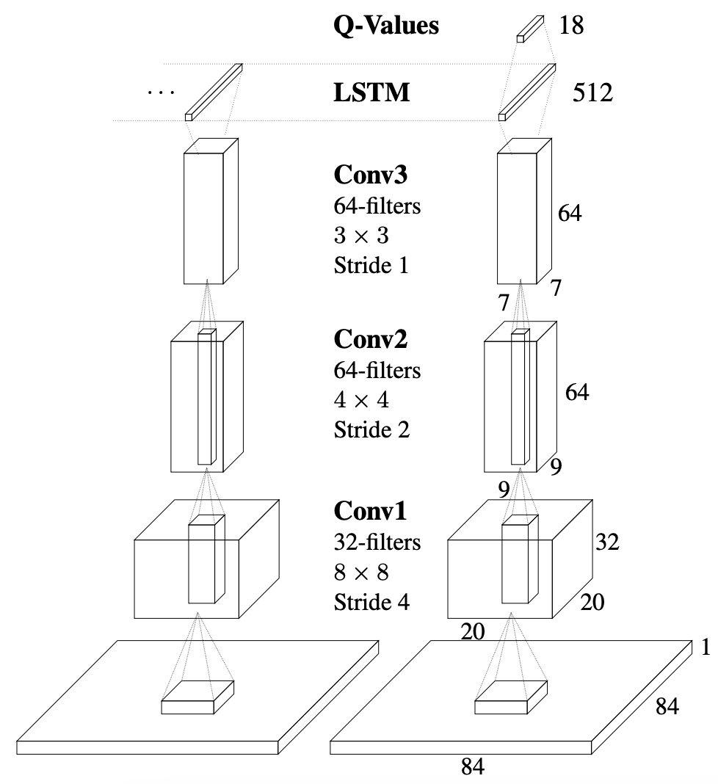
Our DRQN Architecture

Slide 28
Our DRQN Architecture
Modified Architecture: DRQN retains the basic structure of DQN but replaces its first fully connected layer with a recurrent LSTM layer, allowing it to capture temporal dependencies.
Input Processing: The architecture takes a single preprocessed image of size 84x84 as input, which is then processed through three convolutional layers. These layers extract features from the image before feeding them into the LSTM layer.
Joint Learning: During training, the parameters of both the convolutional and recurrent parts of the network are learned jointly from scratch. This ensures that the model learns to extract meaningful features from the input images and utilize them effectively in the Q-value estimation process.

Slide 29
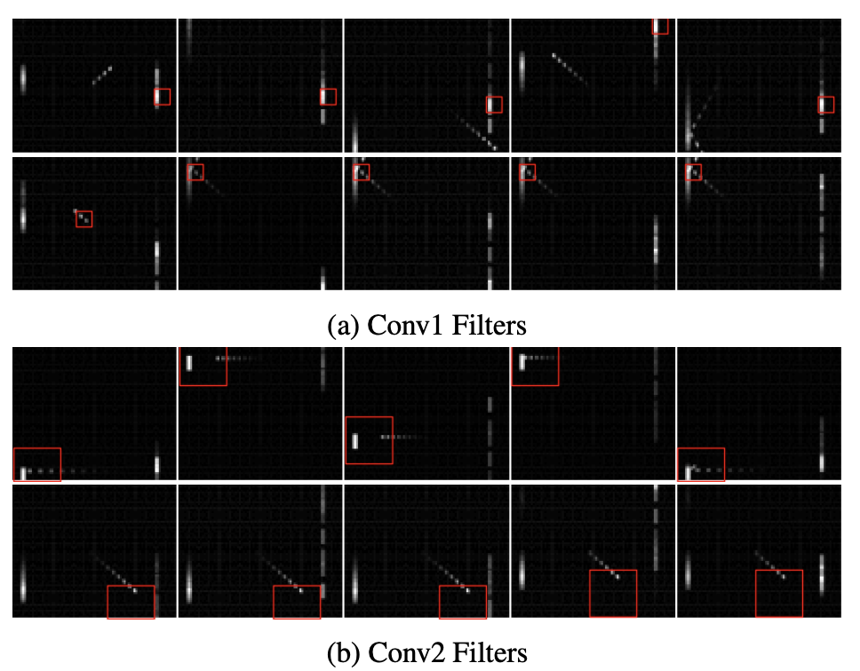
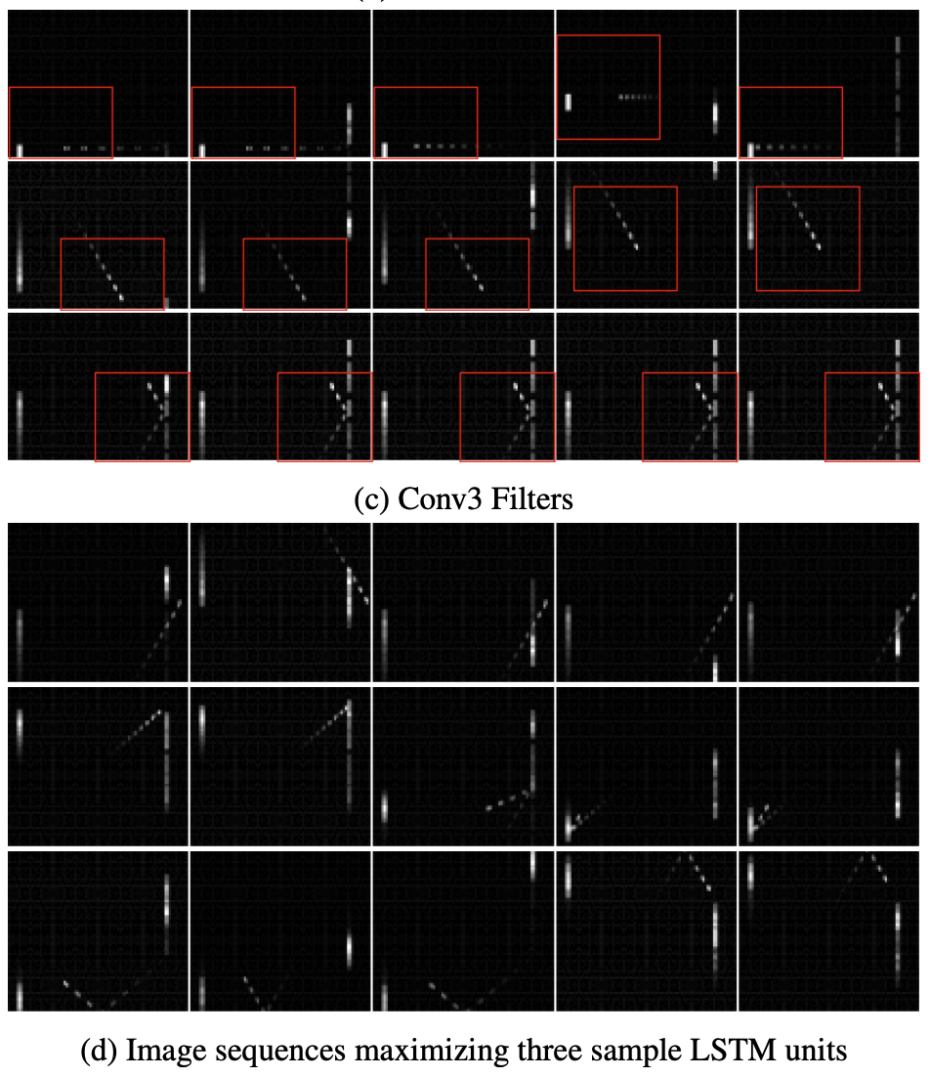
Our DRQN Architecture : Convolutional Layers

Slide 30
Our DRQN Architecture: Convolutional Layer
Convolutional Filters Behavior: The filters in different layers of DRQN detect various aspects of the game. The first layer mainly notices the paddle, while the second layer tracks ball movement and interactions with the paddle. The third layer monitors complex interactions like ball speed and direction.
Integration of Information: Even with just one frame per step, DRQN's LSTM units can understand important game events, like the player missing the ball or the ball bouncing off paddles and walls. This ability to integrate information over time helps DRQN understand the game dynamics.

Slide 31
Our DRQN Architecture: Convolutional Layer
Compensation for Limited Convolutional Detection: With only one input frame per timestep, DRQN's convolutional layers cannot detect object velocity effectively. However, the higher-level recurrent layer compensates for this limitation by integrating information over time. This enables DRQN to perform well even with limited input information.
Training and History Access: During training, DRQN learns from the past ten frames. Both the standard DQN and the recurrent DRQN have access to this history, helping them understand the game's context better over time.

Slide 32
4. DRQN Vs DQN

Slide 33
DRQN Vs DQN
Evaluation on Standard Atari Games
Similar Performance in MDPs: When evaluating on Atari games where the last four frames provide sufficient information (MDPs), both DQN and DRQN exhibit comparable performance. There is no significant advantage of DRQN over DQN in these scenarios, as indicated by similar scores across various games.
Comparing DQN and DRQN on games Frostbite and Beam Rider:
Frost Ride Comparison:
DQN: Achieves moderate success, able to reliably advance past the first level after 12,000 episodes. Performs similarly to the original implementation on this game.
DRQN: Shows improvement over DQN, able to perform better on Frost Ride compared to DQN, discovering a policy that reliably advances past the first level.

Slide 34
DRQN Vs DQN
Comparing DQN and DRQN on games Frostbite and Beam Rider:
Beam Rider Comparison:
DQN: Performs reasonably well, achieving scores comparable to the original implementation.
DRQN: Experiences a decline in performance compared to DQN on Beam Rider, indicating that the recurrent architecture may not provide significant advantages for this specific game.

Slide 35
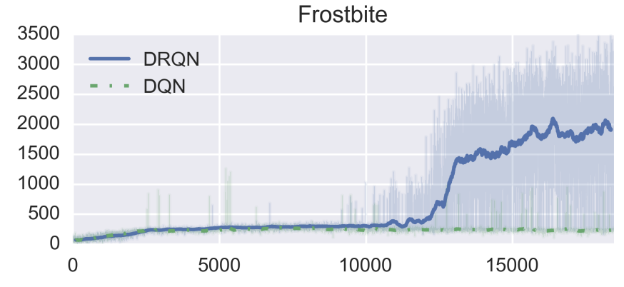
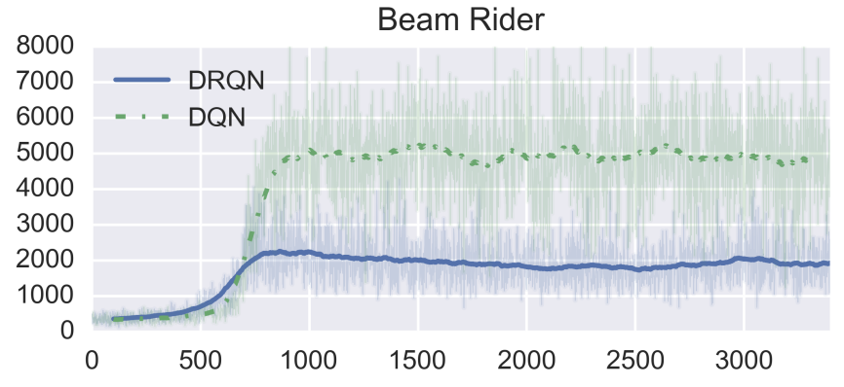
DRQN Vs DQN
Comparing DQN and DRQN on games Frostbite and Beam Rider:
Frostbite and Beam Rider represent the best and worst games for DRQN. Frostbite performance jumps as the agent learns to reliably complete the first level.

Slide 36
DRQN Vs DQN
MDP to POMDP Generalization:
In POMDP environments, DRQN retains more performance than DQN across all levels of flickering, showcasing its robustness against missing information. This suggests DRQN's superior ability to generalize from standard MDPs to POMDPs at evaluation time, underscoring its advantage over DQN in handling partially observable scenarios.

Slide 37
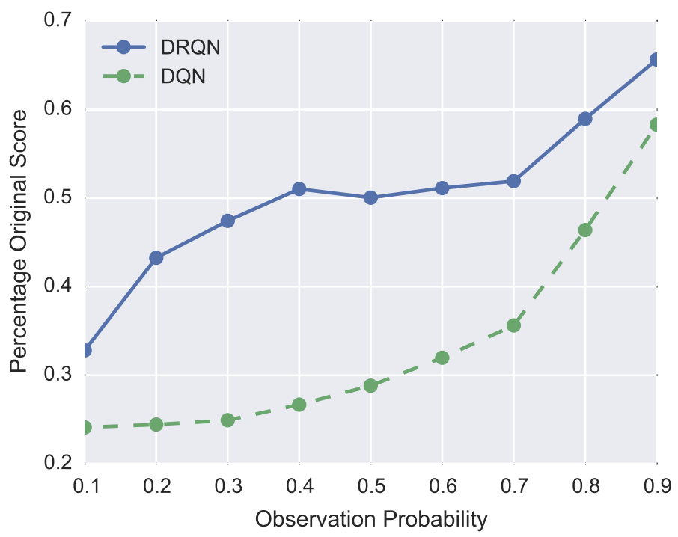
DRQN Vs DQN
MDP to POMDP Generalization:
When trained on normal games (MDPs) and then evaluated on flickering games (POMDPs), DRQN’s performance degrades more gracefully than DQN’s.

Slide 38
4. Conclusion

Slide 39
Conclusion
DRQN demonstrates its efficacy in handling partial observability by integrating information across frames to detect relevant features, such as object velocity, even when provided with only a single frame per timestep.
The scalability of DRQN is evident as it can generalize its policies from partial observations to complete observations, showcasing near-perfect performance as observability increases in the Flickering Pong domain.
While DRQN outperforms DQN in handling partial observability and generalizing across different levels of observability, it shows no systematic advantage over DQN in non-flickering Atari games, highlighting the importance of identifying game-specific characteristics that benefit from recurrent networks.

Slide 40
Future Prospects/Implementation
Smart Traffic Management: Develop a DQN-based traffic management system to optimize traffic flow, reduce congestion, and minimize travel time in urban areas. The agent can learn to control traffic signals dynamically based on real-time traffic conditions.
Real-time Strategy Game AI: Design a DRQN-based AI agent for real-time strategy games (e.g., StarCraft) capable of learning complex strategies, adapting to opponents' moves, and making decisions in dynamic and uncertain environments.
Autonomous Drone Navigation: Implement a DRQN-based navigation system for autonomous drones to navigate complex environments, avoid obstacles, and perform tasks such as package delivery or search and rescue missions.

